Slide 1

How as disruptors do we manage technology enhancements for businesses in this ‘new era’ of so called ‘digital transformation’?
Andrew Pope
11th December 2020

Slide 2
What is the definition of digital transformation?
Digital: Pertaining to, or using digits as applied to a computer,
Transformation: The act or process of changing completely.
Make reference to:
Information Technology (IT) department or team,
Under the control of:
Chief Information Officer (CIO), a Chief Technology Officer (CTO) or a Chief Digital Officer (CDO).
Notes:
It could be argued we’ve all been doing digital transformation since 1989 when the Oxford English Dictionary defined digital as: pertaining to, or using digits as applied to a computer. That said, today’s business leaders are waking up to the fact that they should embrace technology to help drive their business.
In this presentation I will refer to the Information Technology (IT) department or team, who typically provide digital services and digital transformation to a business under the control of a Chief Information Officer (CIO), a Chief Technology Officer (CTO) or a Chief Digital Officer (CDO).

Slide 3
What does ‘digital transformation’ mean to a business?
Empowering customers,
Providing staff with one way of accessing data and information,
Having the ability to pull data from all parts of an organisation,
Providing the staff with more efficient processes.
Ultimately help drive up revenue, reduce costs to increase profits!
Notes:
In terms of ‘digital transformation’ many businesses think it means the following:
Empowering customers to manage their interaction with a business from a personal computer / tablet / mobile phone; such as initial sale through to order, including having access to historical documentation such as bank statements, previous sales transactions and even medical notes;
Providing staff with ideally one single way of accessing data and information, ideally with one device and one common set of graphical user interfaces; this is especially prevalent where businesses have merged or there is a reliance on old legacy systems;
Having the ability to pull data from all parts of an organisation, sometimes referred to as business intelligence, so that the business can make decisions such as what products or services are more profitable;
Providing the staff with more efficient processes so that when one team finish an item of work all the necessary data and information is passed to the next team is a seamless way.
Ultimately help drive up revenue, reduce costs to increase profits!

Slide 4
Understand the full requirement?
Client wants a bridge, but not a boat!
Notes:
One thing I do with any business stakeholder when looking at their digital transformation or information technology (IT) requirements is to get them to identify exactly what they want as opposed to what they think they need.
A classic scenario to show them is the stakeholder who wanted and bridge, but definitely not a boat. The stakeholder, however, is not prepared the pay the cost and wait for the bridge to be built. When questioned about the boat option they still refuse.
It is at this point we actual ask the stakeholder what do they actually want, the response being they want to communicate with an associate across the water, they are happy to use technology, but as a bear minimum by voice but ideally by sight.
One potential solution is for both to subscribe to a mobile network and make video calls to each other. In other words listen to their requirements then propose a suitable technology solution.

Slide 5



Avoid the client ‘solutionising’ / shadow IT
Thinks he wants a BMW estate?
Actually needs a Land Rover!
Notes:
The next thing I do is to with a stakeholder is to explain to them the issues with stakeholders ‘solutionising’, in other words selecting a solution to fulfil their high level requirements, furthermore, they should avoid ‘shadow IT’ whereby a stakeholder will select and purchase a solution without informing the information technology (IT) team until something goes wrong.
In this scenario the stakeholders goes into the BMW showroom and selects a shiny new BMW estate as it will enable them to transport their family and family dog.
However, what the stakeholder omits to add to their requirement list is the fact that they live in a remote location, which is subject to getting high snow falls.
So what they should have selected was probably a Land Rover!

Slide 6
Definitions
Service delivery:
Service desk,
Desk side support,
Access control,
Change control,
Network operating centre (NOC),
Security operating centre (SOC).
Business systems software applications (products):
Core,
Back office,
Non core,
Software as a service (SaaS).
Service Delivery
Applications
Unified communications
Infrastructure
Infrastructure hardware
End user devices (EUD’s) including desktop / laptop computers and tablets,
Networks including local area networks (LANs) and wide are network (WAN),
Data centres; on premise, hosted, infrastructure as a service (IaaS) and cloud,
Information security devices.
Unified communications
Telephony including voice over internet protocol (VoIP),
Mobile communications,
Video conferencing.
Notes:
Back to establishing the digital transformation. First things first, some high level definitions:
Business system software application, sometimes referred to as products, which consist of core systems required for the business to function, back office systems to support the business and non core systems which may consist stand alone systems to support specific business functions. Whereas traditionally most systems may have been hosted ‘in house’, in other words on ‘in house’ servers and computers more and more applications being provided are done so as ‘software as a service’ (SaaS), in other words hosted externally by a software provider. Examples of this are Office 365, whereby email is hosted by Microsoft or customer relationship management (CRM) systems hosted by Salesforce;
Infrastructure, or ‘hardware’, consisting the devices required in order to host or operate the software systems, such as end-user devices (like laptop and desktop computers or tablets and other mobile devices), network equipment and data centres, including on premise, externally hosted, infrastructure as a service (IaaS) and ‘cloud’; I also include information security devices such as firewalls as part of infrastructure;
Unified communications, used to be considered as just telephony, which whereas it used to be hardware is now a mix of hardware and software. Furthermore unified communications also expands to mobile communications and video conferencing;
Finally all three elements managed together by Service Delivery, more than just a Service Desk and desk side support but also access control along with network & security operating centres.
Definitions aside, applications are the one we should focus on first in order to understand our digital transformation requirements.

Slide 7
Developing IT Strategy in line with business strategy
Doing
Money & people
Selling
Business intelligence
Infrastructure layer, consisting EUD, LAN, WAN, data centre, cloud service, internet
eCommerce website
Empowering customers
Operational efficiency
CRM
(sales database)
MRP
(production system)
Single version of the truth
ERP
WAN
Finance and HR systems
Data warehouse and business intelligence
Staff single point of access
Internet
Information governance and information security layer
Notes:
So to the tough bit, trying to establish what the business has in terms of technology and what digital enhancements do they need. In other words trying to establish a digital transformation or an IT strategy in line with the business strategy.
Firstly I go back to basics: In most businesses there are people and processes doing the selling; some are doing the doing, such as manufacturing a product, providing a service, distributing products or a mixture of all three. Finally someone has to manage money and organise the people.
When we take that high level view and look at what software application systems the business already have, we may find: a customer relationship management (CRM) system or sales data base, a manufacturing resource planning (MRP), a finance and a human resources (HR) system. We may even have an enterprise resource planning (ERP) system, which does a combination of manufacturing, distribution, finance and people planning.
Many organisations may already have some form of data warehouse and business intelligence system for reporting against company activities, others may already have some form of eCommerce web site enabling customers to place orders via the internet.
However, all too often these systems are not fully integrated and we sometimes struggle to establish the actual single version of the truth.
Quite often a high level overview of an organisation’s systems may stop there, but we also have to establish how its all held together from an infrastructure perspective and from an information security & information governance perspective.
It’s at this point we can start to establish what needs to be done to bolster up this environment or even replace some of it in order to achieve the required digital enhancements. Ideally if we have identified such enhancements and improvements we are then able scope our deliverables to the business in terms of:
Getting that single point of access for the staff;
Empowering the customer to place orders and obtain access to historical information;
Achieve an accurate and up to date access to business intelligence information;
And achieve the desired operational efficiency.

Slide 8
2019
2020
2021
2022
2023
2024
CBL Acute & Rehab open
with EPR Feb20
Continued investment in new systems/ improvements to existing systems
Introduce more digital enhancements as IT infrastructure and systems become more stable
Data centre server software EoL Dec19
Data centre hardware EOL May21
(migrate to cloud in line with Dynamics CRM and Office 365)
NHS full digital compliance target Dec24
Suggested target date to be fully digital Jun20
Circle key milestones
Digital Global Exemplars
(DGEs) already fully digital
NHS full digital compliance target Dec24
Fast Followers (FFs)
Already well on track to be fully digital
Other NHS provider’s milestones
Revenue £
Potential aim to retain revenue against competition by introducing IoT as well as maintaining cyber threat free digital systems
%age Revenue £
Potential short term loss of revenue until fully digital
Potential loss of revenue against competition(with poor digital adoption)
IT spend
Potential lost revenue and additional cyber security costs
IT investment increases as organisation becomes more digital and threat of cyber security increases
Notes:
So, we’ve established what needs to be done in order for the business to achieve more revenue, become more efficient and ideally reduce costs in order to ultimately increase profits. But how, do we persuade stakeholders and senior management to invest?
This is an example of something I presented with my current client, a private healthcare provider, who in addition to treating privately insured and self pay patients also treat NHS referral patients.
Firstly I indicated some key milestones where investment had to be made, in particular I suggested that the organisation should be compliant with NHS’s digital’s Dec’2024 compliance target well before this date, which is when all providers of NHS services have to be fully digital with no paper records! Without that compliance you can no longer trade with the NHS.
I showed that other NHS providers were already well ahead and had achieved the ‘fully digital’ target or were well on their way to achieving compliance, known as Digital Global Exemplars and Fast Followers respectively.
I then went on to show if they did nothing they would follow the red line and start losing business to the DGEs / FFs. However, by investing in improvements in the right way over time their revenue should increase, albeit it may be a saw tooth effect not only when they became compliant but also in time as they introduced further enhancements. The downsize would be to increase their IT spend against a higher %age revenue spend. More on %age revenue spend on the next slide.
One other item of bad news to break to the board is that the more digital an organisation becomes the higher their cyber security threat, so it goes hand in hand that the more you spend on digital the more you need to spend on your information security.

Slide 9
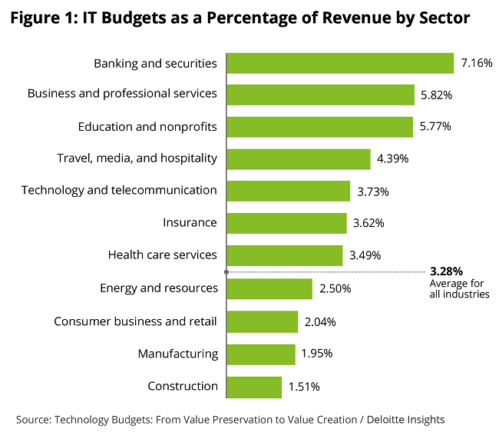
Warning
Smaller revenue organisations have less economies of scale, cost per user can be higher than in larger revenue organisations!
Notes:
This bar chart from Deloitte is typical of charts from other consultancies including the likes of Gartner, which shows IT spend against %age revenue across different sectors.
All too often we see businesses spending between 1% to 2% of their revenue on IT, but to be truly digital they need to be increasing the percentage spend. For example banking & financial services, who already have a good level of digital maturity, spend 6.6%; some healthcare providers are at 3.5%, but surprisingly some retail providers are as low as 1.5%, possibly the ones that have been struggling throughout the current pandemic.
There is warning when referencing this type of data. Typically the information is obtained from large revenue organisations, who may have better buying power than smaller revenue organisation. Smaller revenue organisations
I recently experienced this when my current client (£155 million revenue private healthcare organisation) acquired a larger competitor (£875 million revenue organisation). Both organisations had comparable IT estates, but my client’s cost per user was £3,750 per user pa as opposed to the acquired organisation’s cost per user was £2,100. Net result, my client was investing 3% of annual revenue on IT spend whereas the acquired organisation was only investing 2% of annual revenue.

Slide 10
Supply and demand – typical issues
Strategic
Tactical
Business as usual (BAU)
Demand
Supply
Including
‘hero supply’
and
‘shadow IT’
Internal resources
External resources
Notes:
So having defined your digital requirements and obtained sign off from the board, you need to implement the strategic changes. I find this typical supply and demand funnel helps us to establish if we have the appropriate resources and the focus to carry out these changes.
I find that all too often where businesses have not invested enough time and money on understanding their IT requirements, this typically happens. The IT team are constantly battling with business as usual (BAU) activities, which can lead to two things: i) IT become heros when they have to work all night, whereas if they have invested time and money more appropriately they could have avoided it; ii) the business gets fed up with the IT department and goes off to do their own thing, which results in ‘shadow IT’.
In addition, without any direction on the IT strategy in line with the business strategy the IT team are inundated with ’tactical projects’ and little or no strategic projects. Furthermore, with this lack of control filling the demand funnel combined with the high level of BAU work results in the IT team struggle to meet with demands.

Slide 11
Supply and demand – ideal scenario
Strategic
Tactical
Business as usual (BAU)
Demand
Supply
Avoiding
‘hero supply’
and
‘shadow IT’
Internal resources
External resources
Notes:
This, however, is the ideal scenario:
Before starting any strategic transformation, sort out the BAU issues so that they run at a minimum, also cull the tactical projects so that you can not only concentrate on the strategic projects but the supply can manage the demand. I have a simple rule, if it’s not strategic, does not have a business sponsor and a business case I question very hard whether the project should continue.

Slide 12
Resource spectrum
Business owner |  | Business owner in mature org. / IT owner in immature org. | IT owner
Users | Super users | Technical subject matter experts (SMEs) | Technical support | Developer / system supplier
Define requirements
Approve scope / deliverables
Attend user training
Carry out user acceptance testing (UAT)
Use system in line with approved business processes
Define future requirements
Configure system in line with requirements and approved level of governance
Assist with training and UAT
Assist with support
Define scope in line with requirements
Develop and carry out system testing
Carry out modifications until UAT approved
Provide technical support as required by SMEs
Develop in line with future requirements
Help drive up revenue, reduce costs and increase profits!
Notes:
The final area I always like to address with the stakeholders is the fact that the success of a technology enhancement and on going use of such is reliant on a good working relationship between the business and the IT team.
This simplified resource spectrum shows users and super users of systems under the control of a business owner, whilst the associated technical support and developer / system supplier are under the control of and IT owner. The technical subject matter experts in the middle are always open for negotiation. I find in mature, well established organisations the SMEs sit within the business whereas less mature may sit with the IT team.
What we can here is, the business takes full responsibility for defining the requirements, approving the system design, carrying out user acceptance testing (UAT) and ultimately using the systems correctly whereas the IT team take on the responsibility to supply a working system in line with such requirements and approval. In addition the technical subject matter experts configure the system in line with requirements and approved levels of governance. They also assist the business with training and UAT along with supporting the IT team with ongoing support.
Combining this with the ongoing future requirements and development of the system hopefully the business will gain the most from the systems and achieve their goal of using technology to help drive up revenue, reduce costs and increase profits!

Slide 13
Conclusion
Defined digital transformation,
Educated the business to define their requirements,
Definitions,
Obtain stakeholder approval,
Prioritise ‘supply and demand’,
Business input we need for successful digital enhancements.
We haven’t looked at system selection or project / programme methodologies, but leave that for another discussion!
Notes:
In conclusion we have:
Defined digital transformation;
Educated the business that they need to define their requirements, avoid ‘solutionising’ and ‘shadow IT’;
Looked at the definitions of the main system building blocks that are required to enable digital enhancements;
Looked at how to obtain stakeholder approval;
Looked at how to prioritise ‘supply and demand’
Finally looked at what business input we need for successful deployment of digital enhancements.
We haven’t looked at system selection or project / programme methodologies, but leave that for another discussion.

Slide 14
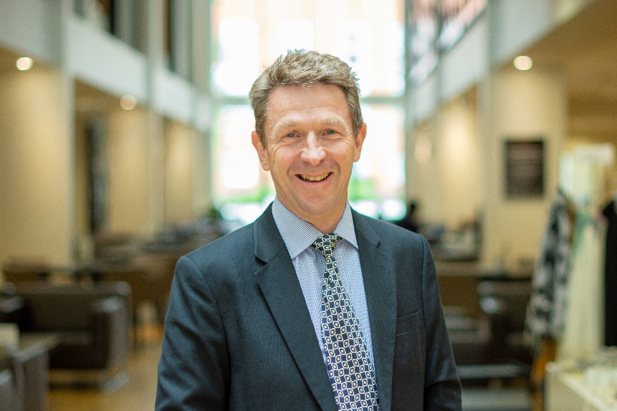
Thank you / any questions?
Andrew Pope
Leam Consultancy Limited
Andrew.pope@leamconsultancy.com
+44 (0) 7905 865815
Notes:
Thank you very much, any questions now or feel free to contact me directly to discuss.

