Slide 1
Your Brand and Why it Matters
Notes:
Why the Members of transformation leaders should worry about their brand and understand

Slide 2
Brand Peter Henry
Polymath enhanced by a broad range of specialist connections
Iconoclast represented by the Hawaiian Shirt
Business Strategist focused on fundamentals
Person centric with Coaching and Mentoring integral to relationships
Financially independent and driven by the challenge to deliver delighted successful clients
Adamant Speaker of Truth to Power
Focus on (Business and Personal) Growth
Notes:
Unsolicited comment on LinkedIn from one of my clients and insolvency practitioner yesterday
Met my mentor Peter yesterday to discuss strategy – where would I be without him! He keeps my feet on the ground.

Slide 3
What You Need to Take Away Today
Why you need a Brand with clearly defined ethos and values
As a Member your Brand must be consistent with T-L’s
Your Website, LinkedIn, social media and all marketing and sales collateral etc. should reflect and represent your Brand
Notes:
PH

Slide 4
CIM Definition of a Brand
“The set of physical attributes of a product or service, together with the beliefs and expectations surrounding it - a unique combination which the name or logo of the product or service should evoke in the mind of the audience.”
Notes:
PH

Slide 5
The Essence of Brand
Any brand has three interrelated elements
What the brand is/does/ offers customers (Functional)
The core values of the brand which make it important to customers (Evaluative)
The effect that using the brand has on customers (Psychological)
Notes:
PH

Slide 6
Why is a Brand Important
Simply Stated
A strong brand enables sustainable added value
The purpose of any business is to add value
Sustainable added value delivers better profits
Notes:
PH

Slide 7
“Accounting software for business finance management Whether you're a start-up or a small business, our business accounting software makes it easy to manage your records and run your company. You can even automate repetitive financial tasks and create custom invoices.”
“Cloud accounting software for small businesses. Accounting software that works for you. Save around 8 hours a month managing your accounts.”
“Online accounting software for beautiful business – Xero takes care of the numbers so you can spend more time on what you love.”
Notes:
AL

Slide 8



Notes:
AL

Slide 9

A Case History
Liberalisation of UK Energy Market
What the brand delivers: Trusted physical and emotional warmth
What is does for the customer: Turns houses into homes
Notes:
Consumer research by competition led them and the regulator to believe that customers would switch for a 5% discount.
This research failed to understand the power of the British Gas Brand compared with the main competitors the regional electricity company’s.
The regulator believed that BG would lose 75% share whereas in reality BG Retained 75%
Amarada Hess story in the South-West trial area.

Slide 10

Nota Bene
A Logo is not a brand
Notes:
PH

Slide 11
Why a Brand is Important
Every company has a brand either explicit or implicit which is created and influenced by everything the company and its employees do.
If this brand is understood and used effectively it can extremely useful in adding value by increasing awareness, image and saliency
And by differentiating your products and services from your competitors increased margins are possible (through higher perceived value)
However the result of not managing your brand can lead to reduction in added value and margin, perhaps reducing what you supply to the level of commodity

Slide 12
But how do you set about understanding your brand?
What You Do: Develop a comprehensive list of all the products/services/activities that you provide to clients
Competitive Advantage: Thinking about this list, consider where you add the greatest value, that is, has the greatest competitive advantage.
What Business are You In? From these first two steps define what business you are in. This is not what you do but is crucial as it defines the biggest space in which you can operate successfully
Take this information and construct the nine box matrix

Slide 13
Brand Positioning Matrix
Functional Purpose
What the brand is/does/ offers customers
FF
Effect on Users
What the brand is like to use
FE
Functional Role
The functional role which the brand plays in customers’ lives
FP
Customers’ view of brand attributes
What research reveals that customers say about the brand EF
Pivotal Core Values
The core values of the brand which make it important to customers
EE
Media Trigger
The persuasion strategy to trigger the desired customer response EP
Psychological Role
The psychological (mental ) role which the brand plays in peoples lives PF
Brand Personality
The ‘human’ character & personality of the brand
PE
Psychological Needs
The psychological needs that the brand delivers for customers
PP
Notes:
The Brand Positioning Matrix was developed by Norman Strauss – Brand supremo for Lever Bros.
I worked with Norman to develop the British Gas brand in the mid 1990’s and learned both its power and how to carry out the excercise

Slide 14
Transformation-Leaders
Brand Positioning

Slide 15
Top Interim Brand Positioning Matrix

Slide 16
The Functional Purpose
What the brand is/does/ offers customers
Identifies the key risks and opportunities
Enables client to make better strategic decisions
Fast access to a choice relevantly qualified independent
In –depth knowledge of the handpicked candidates
Provides a personalised solution (not process)
Structured briefing process
Proven low risk solution/44:44 success
Guaranteed over-delivery: quality, speed and Impact
Best value for money
Simple client/consultant relationship

Slide 17
Pivotal Core Values
The core values of the brand which make it important to customers
Proven & comprehensive knowledge, skills, processes and experience
Proven measurable high return on their investment ((Value for money)
Relishing discovery
Client centric partnering philosophy
Credibility (over delivers, goes beyond brief to achieve outcome)
Do the right thing even when it is very difficult
Pragmatic/Does what it says on the box
Honest/straightforward/trustworthy/supportive
Open and transparent

Slide 18
Psychological Needs
The psychological needs that the brand delivers for customers
Reassurance/Increased confidence (skill/ experience)
Stress reduction (risk avoidance)
Reduced Loneliness (independent partner)
Fear removal (best candidates/proven track record)
Freedom (to expand their horizons)
Simplification (process & contract)
Self worth (inside track to best solution)

Slide 19
Practical Outcomes from a
Brand Positioning Matrix
A fully developed blueprint for your Brand that can be applied across your range of services
The basis of developing the strongest customer proposition and sales platform to highlight your specialty added value
All the information that a design agency will require to develop the brand creatively (Websites Social Media, Marketing Collateral and if necessary Logos and Letterheads)
The tool to aide:
Decisions on whether a new product or service idea is a good fit for the Company
Developing the knowledge and adoption of your core ethos and values by:
  Your Clients
  Distribution Channels

Slide 20
Why Brand alignment with
T-L is so important
Membership of T-L is limited to a very small number of highly talented Independents
If you are asked to meet a potential client you will already be perceived as special
If you have the T-L brand values and then bring your aligned specialist skills, knowledge and experience, then;
In the language of synergy 1+1 = 3

Slide 21


Notes:
AH

Slide 22
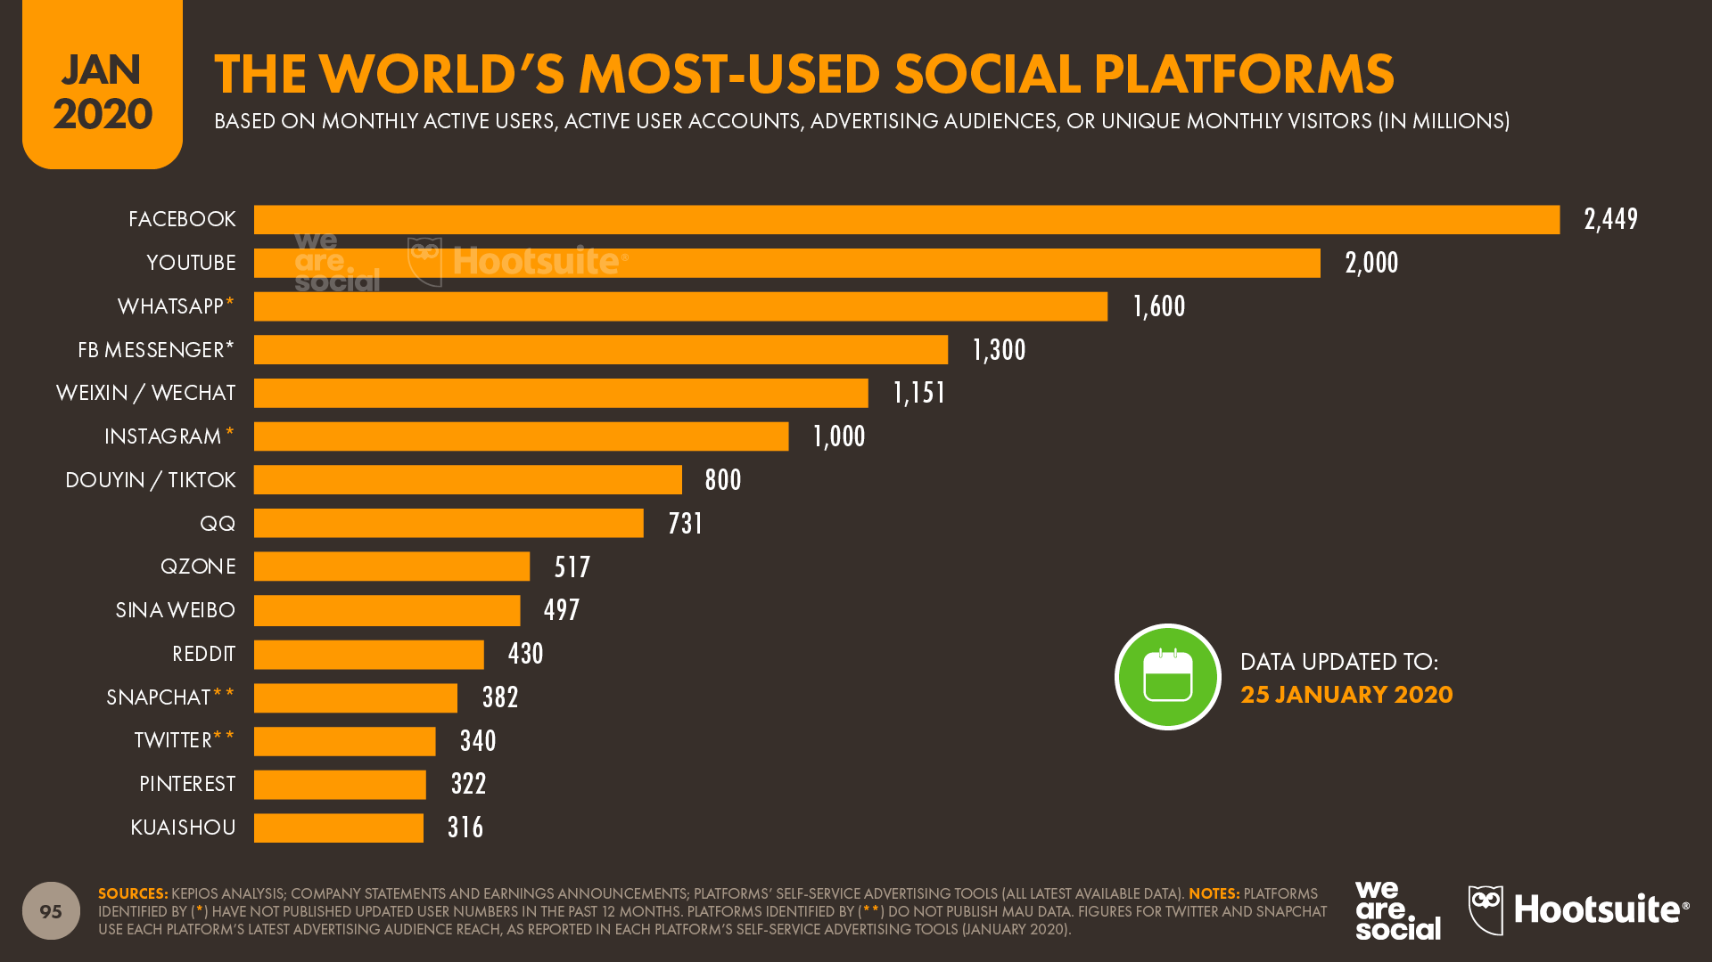
Notes:
AH

Slide 23
Notes:
AH

Slide 24
About 45% of LinkedIn article readers are in upper-level positions (managers, VPs, Directors, C-level).
Notes:
AH

Slide 25
Social Media – Pros and Cons
Pros:
Exposure to large audiences
Two way communications – Builds relationships and loyalty
Real time feedback – Marketplace insights
Cheap compared with traditional marketing

Slide 26
Social Media – Pros and Cons
Cons:
Loss of Control – Brands can be irrevocably damaged
Attracts negative users intent on harming your Brand
Time consuming
ROI hard to measure accurately
Prone to security breaches

Slide 27

Who really controls your Brand on Social Media?

Slide 28

Notes:
Normally, Dove is known for empowering women and focusing on natural, realistic standards of beauty.
The company has been standing on its Real Beauty platform for over 10 years and, most of the time, it’s proven successful. Take, for example, successful campaigns like “Real Beauty Sketches” and "Evolution" that focus on making women feel proud of the way they look.

Slide 29

Social media fail example
Notes:
Unfortunately, in a recent post on Facebook by the company, they’ve taken a ton of steps backward.
The ad in question shows a black woman transformed into a white woman after using Dove body lotion.
This totally goes against their brand message of saying that all beauty is real beauty by showing a woman transforming into an entirely different race after using their product.
It doesn’t fit with their overall brand messaging and both alienates and insults a large part of their audience.
After receiving backlash from women of all races saying the ad made them angry and uncomfortable, Dove removed it from Facebook and released this statement:
As we’ve seen with all the other ads, the apology doesn’t do much but the ad does teach us to always review your content through a critical lens. Make sure that it doesn’t offend or in this case, totally go against what your brand represents.

Slide 30
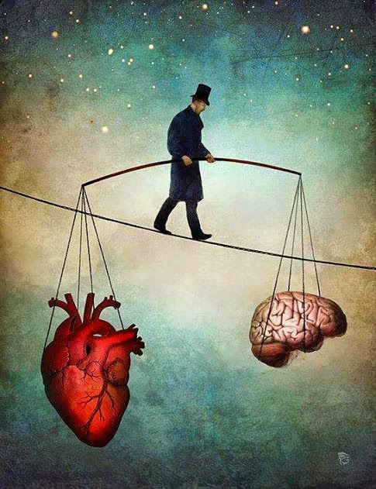
Rational vs Emotional decisions and how Brand plays a part
Notes:
PH

Slide 31
The Car You Drive!
You can tell a lot about people by the car they drive.
So I would like you to self analyse and answer the following questions
What make of car do you drive?
What is you rational explanation?
What is your real (emotional ) reason?

Slide 32
Why the Brand is crucial to winning projects
Humans make many decisions based on the emotional reactions and then post rationalise it
Your brand ‘s emotional aspects will address the client’s important Psychological needs
A big part of the decision will be made on the Brand before you ever meet.

Slide 33

Where should your brand be?
Notes:
The core of brands hasn’t changed but how they work in the modern world has changed.

Slide 34

“the world’s most versatile camera”
Notes:
The core of brands hasn’t changed but how they work in the modern world has changed.
a widely used hashtag (#GoPro). This company makes use of its social media platforms very well by creating value, promoting products, and interacting with their customers.

Slide 35
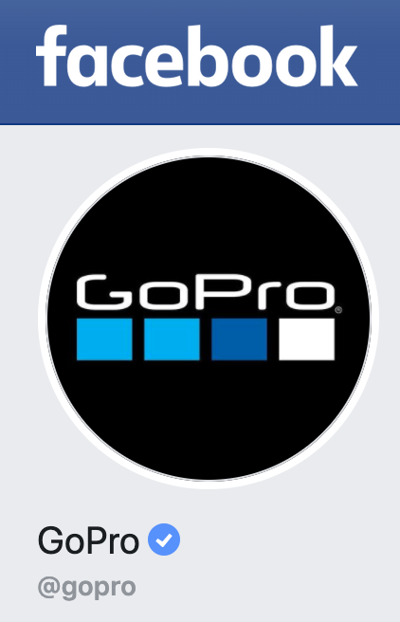
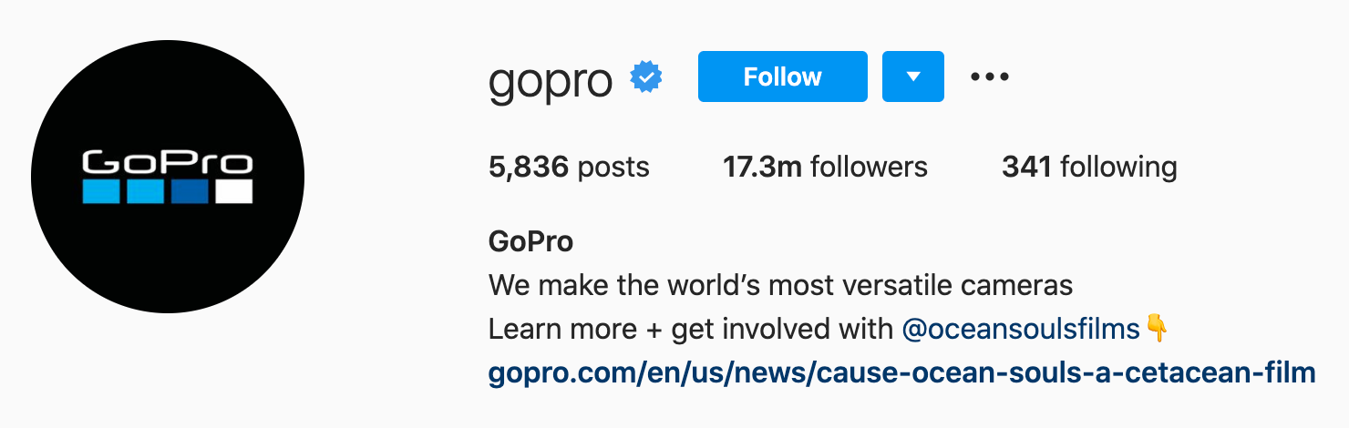
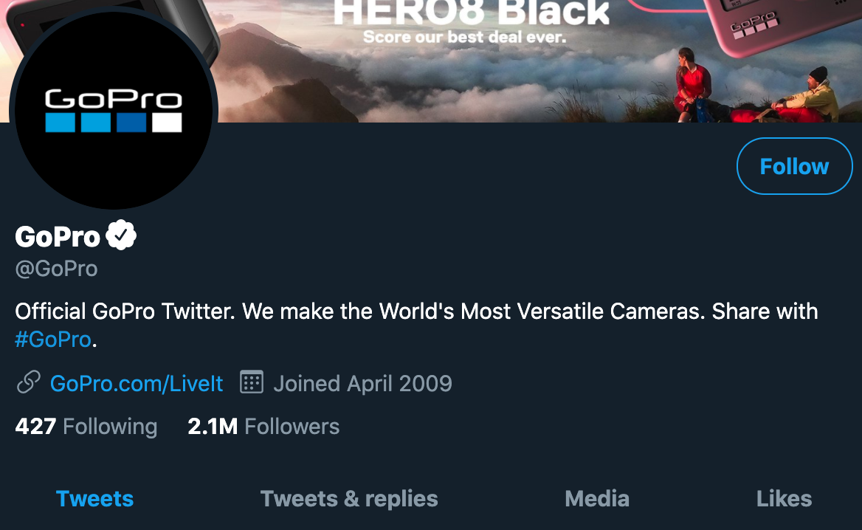

Notes:
9.48M on youtube.
10.8m of Facebook
2.1m on Twitter
17.3M on Instagram
GoPro is present on a lot of platforms, but they’re using each of these networks differently. For instance, they use Facebook to promote their brand, reach new clients, and connect with their existing customers. Instagram is their platform of choice for showcasing the quality of their cameras and promoting user-generated posts. Twitter is used primarily for product announcements as well as for communicating with customers. Their YouTube account is made for uploading videos showing tips and tutorials on how to use their products.

Slide 36
Notes:
9.48M on youtube.
10.8m of Facebook
2.1m on Twitter
17.3M on Instagram
GoPro is present on a lot of platforms, but they’re using each of these networks differently. For instance, they use Facebook to promote their brand, reach new clients, and connect with their existing customers. Instagram is their platform of choice for showcasing the quality of their cameras and promoting user-generated posts. Twitter is used primarily for product announcements as well as for communicating with customers. Their YouTube account is made for uploading videos showing tips and tutorials on how to use their products.

Slide 37
What You Need to Take Away Today
Why it is valuable to have a brand with clearly defined ethos and values
As a Member your brand must be consistent with T-L’s
Your Brand should be evident on your Website, LinkedIn, social media and all marketing and sales collateral etc.

Slide 38
Final task after this session
Do you really understand your own Brand?
Is it compatible with that of Transformation-Leaders?
Do you Know?

Slide 39
Thank You!

Slide 40
Transformation-Leaders
Chairman’s Itch - New Strategy Review Product
A proper subset of the existing product
Scope strictly limited to a strategy review
Fixed Price (variable)
Strictly no project stretch
Core target market, Chairmen with an ‘itch’
Usual Independent recruitment process

